Slide 1

Introduction to
- MOA -
CS50 Final Project
Name: Ahmet Kaan Güney
City, Country: Istanbul, Turkey
Year: 2021

Slide 2
What is MOA?
MOA is a simple tool for editing your matricies.
It's designed for people who want to group their rows and columns easily.

Slide 3
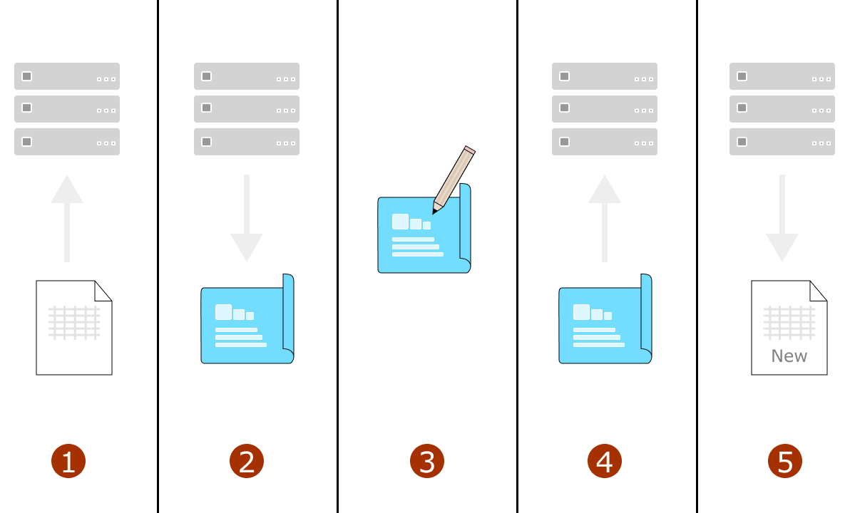
How MOA Works?

Slide 4
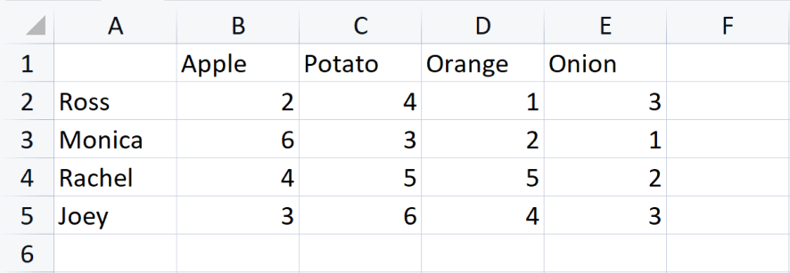
Example

Slide 5
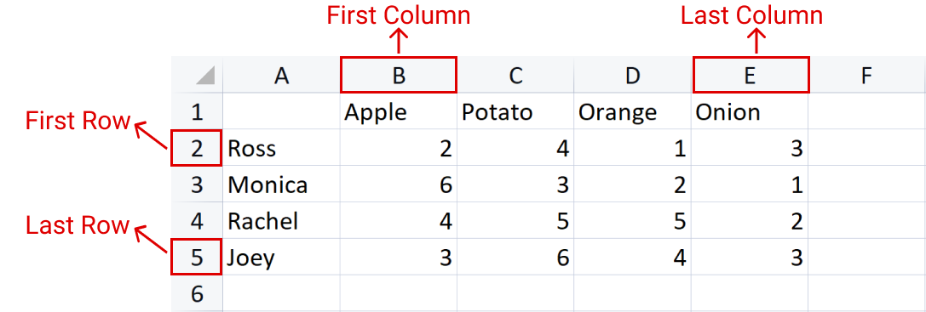
How to enter matrix coordinates:

Slide 6
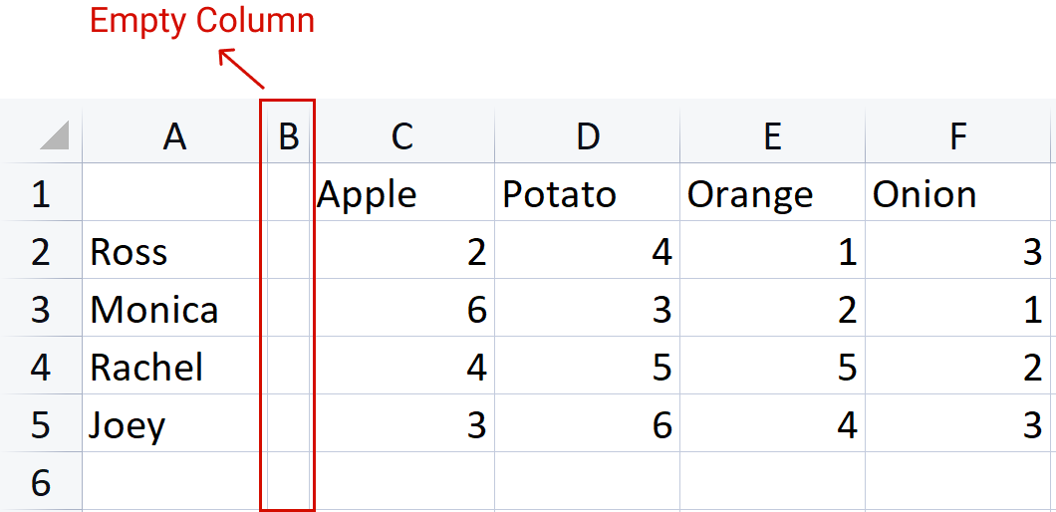
Don’t do:

Slide 7
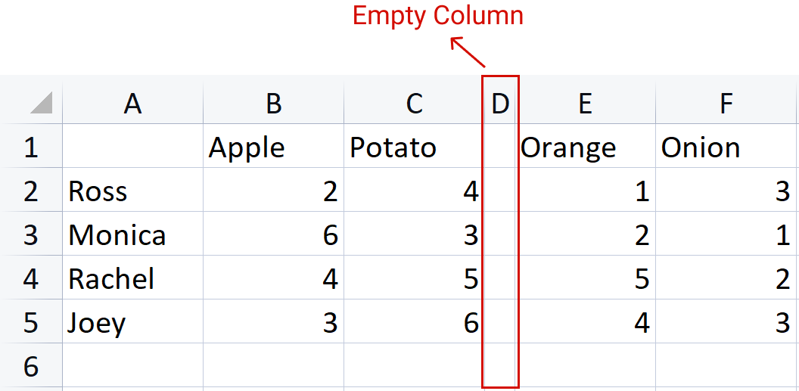
Don’t do:

Slide 8
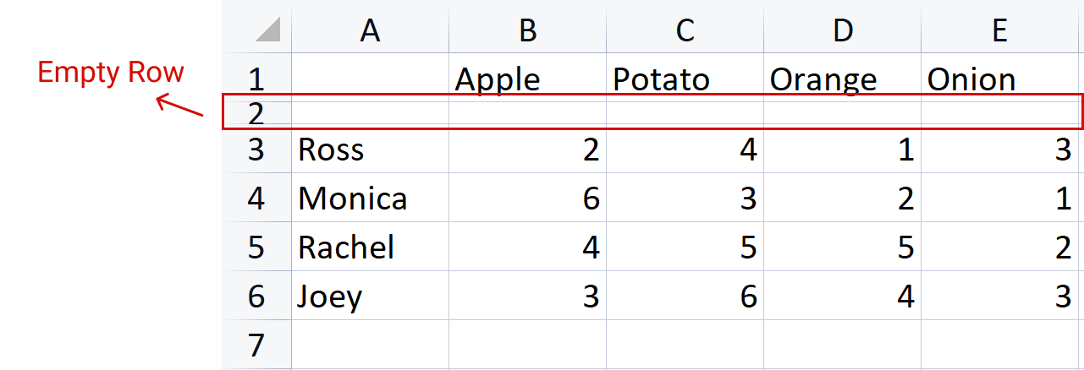
Don’t do:

Slide 9
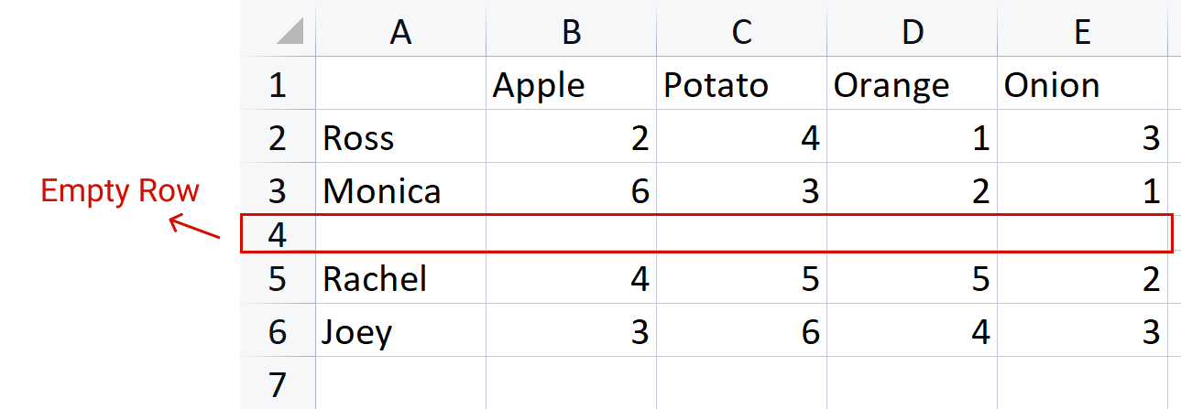
Don’t do:

Slide 10
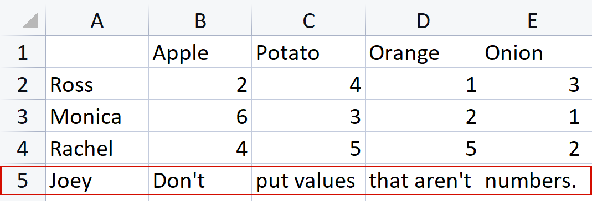
And don’t put values that aren’t number in the cells.

Slide 11
Thanks for watching!

